Slide 1
NOSQL Databases
and Big Data Storage Systems

Slide 2
Introduction
NOSQL
Not only SQL
Most NOSQL systems are distributed databases or distributed storage systems
Focus on semi-structured data storage, high performance, availability, data replication, and scalability
Notes:
Structured Data: Relational Data
Semi Structured: Json,XML

Slide 3
Introduction (cont’d.)
NOSQL systems focus on storage of “big data”
Typical applications that use NOSQL
Social media
Web links
User profiles
Marketing and sales
Posts and tweets
Road maps and spatial data
Email

Slide 4
24.1 Introduction to NOSQL Systems
BigTable
Google’s proprietary NOSQL system
Column-based or wide column store
DynamoDB (Amazon)
Key-value data store
Cassandra (Facebook)
Uses concepts from both key-value store and column-based systems

Slide 5
Introduction to NOSQL Systems (cont’d.)
MongoDB and CouchDB
Document stores
Neo4J and GraphBase
Graph-based NOSQL systems
OrientDB
Combines several concepts
Database systems classified on the object model
Or native XML model
Notes:
OrientDB is an open source NoSQL database management system written in Java. It is a Multi-model database, supporting graph, document and object models

Slide 6
Introduction to NOSQL Systems (cont’d.)
NOSQL characteristics related to distributed databases and distributed systems
Scalability
Availability, replication, and eventual consistency
Replication models
Master-slave
Master-master
Sharding of files
High performance data access

Slide 7
Introduction to NOSQL Systems (cont’d.)
NOSQL characteristics related to data models and query languages
Schema not required
Less powerful query languages
Versioning (Some NOSQL systems provide storage of multiple versions of the data items, with the timestamps of when the data version was created)

Slide 8
Introduction to NOSQL Systems (cont’d.)
Categories of NOSQL systems
Document-based NOSQL systems
NOSQL key-value stores
Column-based or wide column NOSQL systems
Graph-based NOSQL systems
Hybrid NOSQL systems
Object databases
XML databases

Slide 9
24.2 The CAP Theorem
Various levels of consistency among replicated data items
Enforcing serializabilty the strongest form of consistency
High overhead – can reduce read/write operation performance
CAP theorem
Consistency, availability, and partition tolerance
Not possible to guarantee all three simultaneously
In distributed system with data replication

Slide 10
The CAP Theorem (cont’d.)
Designer can choose two of three to guarantee
Weaker consistency level is often acceptable in NOSQL distributed data store
Guaranteeing availability and partition tolerance more important
Eventual consistency often adopted

Slide 11
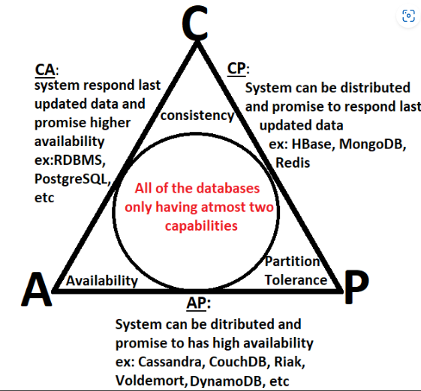

The CAP Theorem

Slide 12
24.3 Document-Based NOSQL Systems and MongoDB
Document stores
Collections of similar documents
Individual documents resemble complex objects or XML documents
Documents are self-describing
Can have different data elements
Documents can be specified in various formats
XML
JSON

Slide 13
MongoDB Data Model
Documents stored in binary JSON (BSON) format
Individual documents stored in a collection
Example command
First parameter specifies name of the collection
Collection options include limits on size and number of documents
Each document in collection has unique ObjectID field called _id

Slide 14
MongoDB Data Model (cont’d.)
A collection does not have a schema
Structure of the data fields in documents chosen based on how documents will be accessed
User can choose normalized or denormalized design
Document creation using insert operation
Document deletion using remove operation

Slide 15
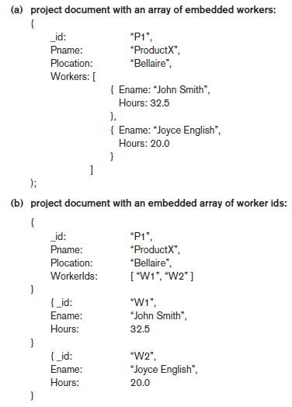
Figure 24.1 (continues)
Example of simple documents in MongoDB (a) Denormalized document design with embedded subdocuments (b) Embedded array of document references

Slide 16
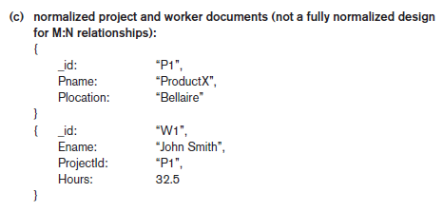
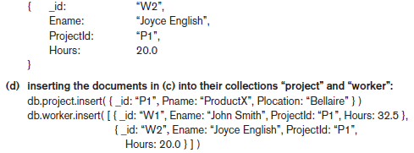
Figure 24.1 (cont’d.) Example of simple documents in MongoDB (c) Normalized documents (d) Inserting the documents in Figure 24.1(c) into their collections

Slide 17
MongoDB Distributed Systems Characteristics
Two-phase commit method
Used to ensure atomicity and consistency of multidocument transactions
Replication in MongoDB
Concept of replica set to create multiple copies on different nodes
Variation of master-slave approach
Primary copy, secondary copy, and arbiter
Arbiter participates in elections to select new primary if needed

Slide 18
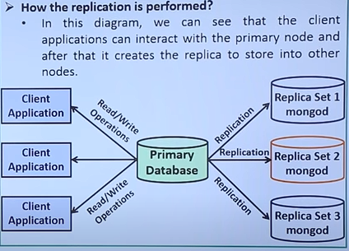
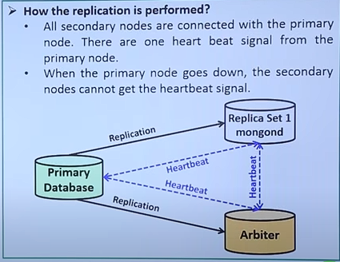
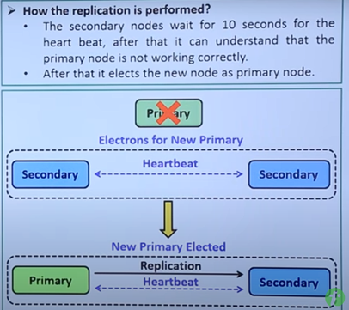
Replication in MongoDB

Slide 19
MongoDB Distributed Systems Characteristics (cont’d.)
Replication in MongoDB (cont’d.)
All write operations applied to the primary copy and propagated to the secondaries
User can choose read preference
Read requests can be processed at any replica
Sharding in MongoDB
Horizontal partitioning divides the documents into disjoint partitions (shards)
Allows adding more nodes as needed
Shards stored on different nodes to achieve load balancing

Slide 20
MongoDB Distributed Systems Characteristics (cont’d.)
Sharding in MongoDB (cont’d.)
Partitioning field (shard key) must exist in every document in the collection
Must have an index
Range partitioning
Creates chunks by specifying a range of key values
Works best with range queries
Hash partitioning
Partitioning based on the hash values of each shard key

Slide 21
24.4 NOSQL Key-Value Stores
Key-value stores focus on high performance, availability, and scalability
Can store structured, unstructured, or semi-structured data
Key: unique identifier associated with a data item
Used for fast retrieval
Value: the data item itself
Can be string or array of bytes
Application interprets the structure
No query language

Slide 22
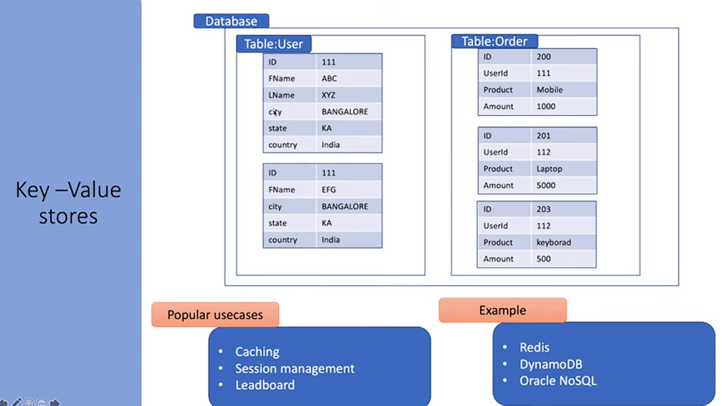

Key-Value Stores
111
112

Slide 23
DynamoDB Overview
DynamoDB part of Amazon’s Web Services/SDK platforms
Proprietary
Table holds a collection of self-describing items
Item consists of attribute-value pairs
Attribute values can be single or multi-valued
Primary key used to locate items within a table
Can be single attribute or pair of attributes

Slide 24
Voldemort Key-Value Distributed Data Store
Voldemort: open source key-value system similar to DynamoDB
Voldemort features
Simple basic operations (get, put, and delete)
High-level formatted data values
Consistent hashing for distributing (key, value) pairs
Consistency and versioning
Concurrent writes allowed
Each write associated with a vector clock

Slide 25
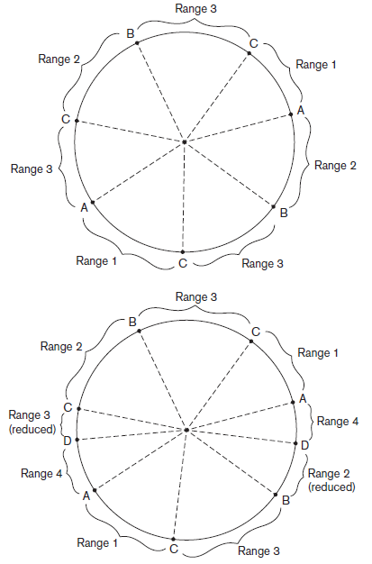
Figure 24.2 Example of consistent hashing (a) Ring having three nodes A, B, and C, with C having greater capacity. The h(K) values that map to the circle points in range 1 have their (k, v) items stored in node A, range 2 in node B, range 3 in node C (b) Adding a node D to the ring. Items in range 4 are moved to the node D from node B (range 2 is reduced) and node C (range 3 is reduced)

Slide 26
Examples of Other Key-Value Stores
Oracle key-value store
Oracle NOSQL Database
Redis key-value cache and store
Caches data in main memory to improve performance
Offers master-slave replication and high availability
Offers persistence by backing up cache to disk
Apache Cassandra
Offers features from several NOSQL categories
Used by Facebook and others

Slide 27
24.5 Column-Based or Wide Column NOSQL Systems
BigTable: Google’s distributed storage system for big data
Used in Gmail
Uses Google File System for data storage and distribution
Apache Hbase a similar, open source system
Uses Hadoop Distributed File System (HDFS) for data storage
Can also use Amazon’s Simple Storage System (S3)

Slide 28
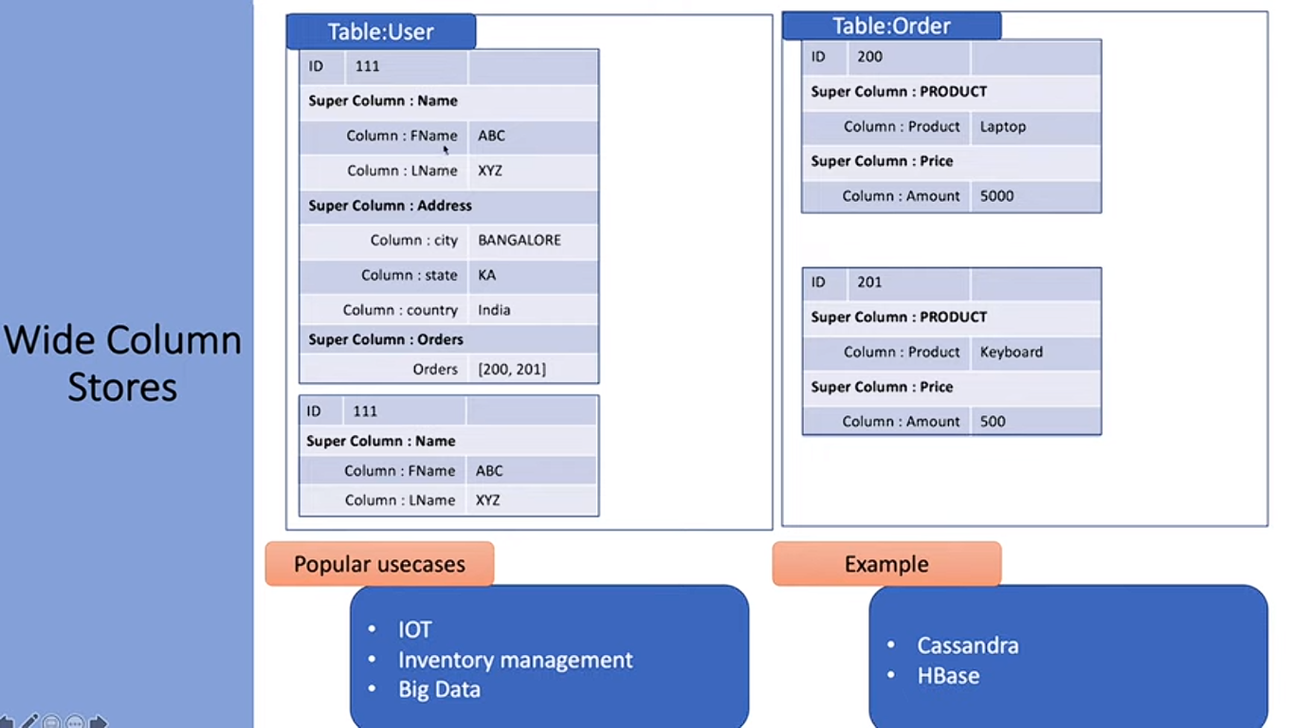
Column-Based or Wide Column NOSQL Systems

Slide 29
Hbase Data Model and Versioning
Data organization concepts
Namespaces
Tables
Column families
Column qualifiers
Columns
Rows
Data cells
Data is self-describing

Slide 30
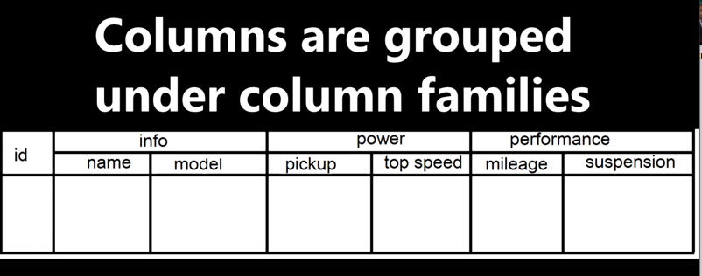
Hbase Data Model

Slide 31
Hbase Data Model and Versioning (cont’d.)
HBase stores multiple versions of data items
Timestamp associated with each version
Each row in a table has a unique row key
Table associated with one or more column families
Column qualifiers can be dynamically specified as new table rows are created and inserted
Namespace is collection of tables
Cell holds a basic data item

Slide 32
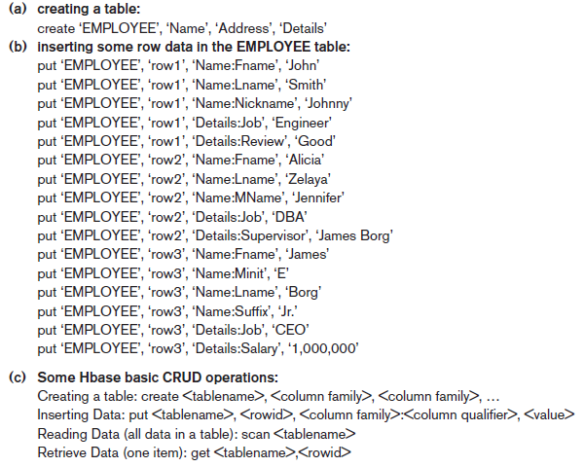
Figure 24.3 Examples in Hbase (a) Creating a table called EMPLOYEE with three column families: Name, Address, and Details (b) Inserting some in the EMPLOYEE table; different rows can have different self-describing column qualifiers (Fname, Lname, Nickname, Mname, Minit, Suffix, … for column family Name; Job, Review, Supervisor, Salary for column family Details). (c) Some CRUD operations of Hbase

Slide 33
Hbase Crud Operations
Provides only low-level CRUD (create, read, update, delete) operations
Application programs implement more complex operations
Create
Creates a new table and specifies one or more column families associated with the table
Put
Inserts new data or new versions of existing data items

Slide 34
Hbase Crud Operations (cont’d.)
Get
Retrieves data associated with a single row
Scan
Retrieves all the rows

Slide 35
Hbase Storage and Distributed System Concepts
Each Hbase table divided into several regions
Each region holds a range of the row keys in the table
Row keys must be lexicographically ordered
Each region has several stores
Column families are assigned to stores
Regions assigned to region servers for storage
Master server responsible for monitoring the region servers
Hbase uses Apache Zookeeper and HDFS

Slide 36
24.6 NOSQL Graph Databases and Neo4j
Graph databases
Data represented as a graph
Collection of vertices (nodes) and edges
Possible to store data associated with both individual nodes and individual edges
Neo4j
Open source system
Uses concepts of nodes and relationships

Slide 37
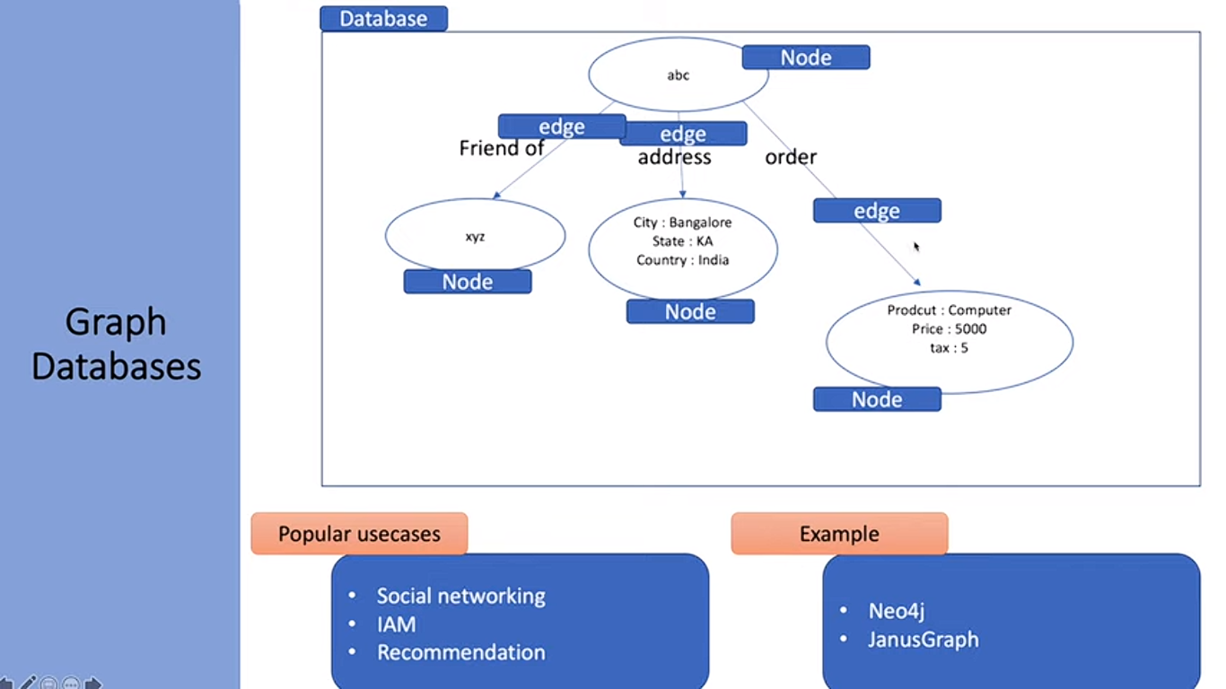
NOSQL Graph Databases and Neo4j

Slide 38
Neo4j (cont’d.)
Nodes can have labels
Zero, one, or several
Both nodes and relationships can have properties
Each relationship has a start node, end node, and a relationship type
Properties specified using a map pattern
Somewhat similar to ER/EER concepts

Slide 39
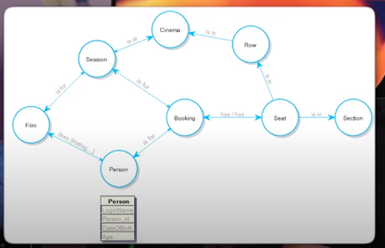
Neo4j

Slide 40
Neo4j (cont’d.)
Creating nodes in Neo4j
CREATE command
Part of high-level declarative query language Cypher
Node label can be specified when node is created
Properties are enclosed in curly brackets

Slide 41
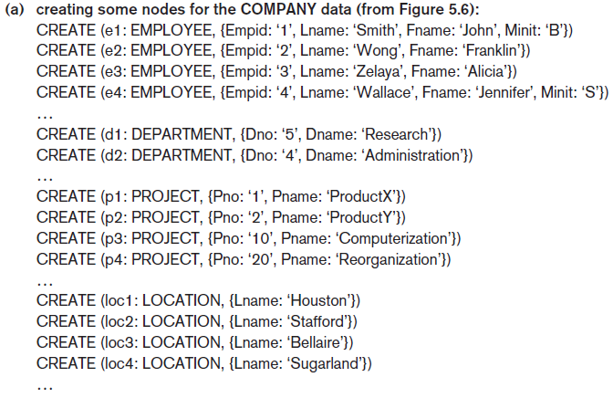
Neo4j (cont’d.)
Figure 24.4 Examples in Neo4j using the Cypher language (a) Creating some nodes

Slide 42
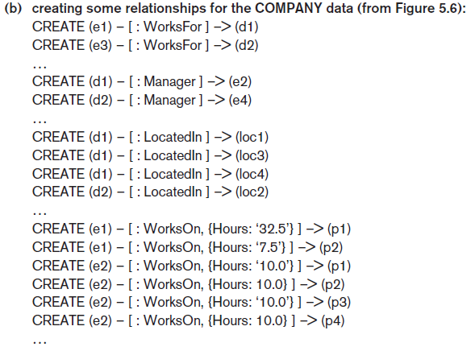
Neo4j (cont’d.)
Figure 24.4 (cont’d.) Examples in Neo4j using the Cypher language (b) Creating some relationships

Slide 43
Neo4j (cont’d.)
Path
Traversal of part of the graph
Typically used as part of a query to specify a pattern
Schema optional in Neo4j
Indexing and node identifiers
Users can create for the collection of nodes that have a particular label
One or more properties can be indexed

Slide 44
The Cypher Query Language of Neo4j
Cypher query made up of clauses
Result from one clause can be the input to the next clause in the query

Slide 45
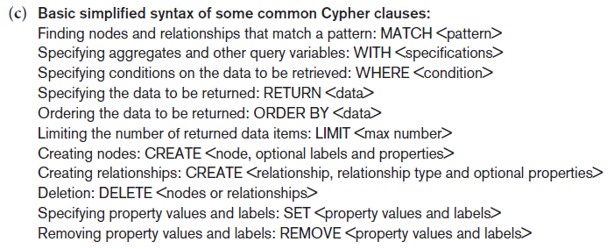
The Cypher Query Language of Neo4j (cont’d.)
Figure 24.4 (cont’d.) Examples in Neo4j using the Cypher language (c) Basic syntax of Cypher queries

Slide 46
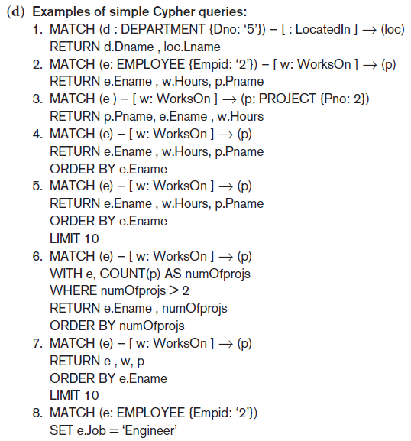
The Cypher Query Language of Neo4j (cont’d.)
Figure 24.4 (cont’d.) Examples in Neo4j using the Cypher language (d) Examples of Cypher queries

Slide 47
Neo4j Interfaces and Distributed System Characteristics
Enterprise edition versus community edition
Enterprise edition supports caching, clustering of data, and locking
Graph visualization interface
Subset of nodes and edges in a database graph can be displayed as a graph
Used to visualize query results
Master-slave replication
Caching
Logical logs

Slide 48
24.7 Summary
NOSQL systems focus on storage of “big data”
General categories
Document-based
Key-value stores
Column-based
Graph-based
Some systems use techniques spanning two or more categories
Consistency paradigms
CAP theorem

